Slide 1
Measure Box design ideas V2

Slide 2
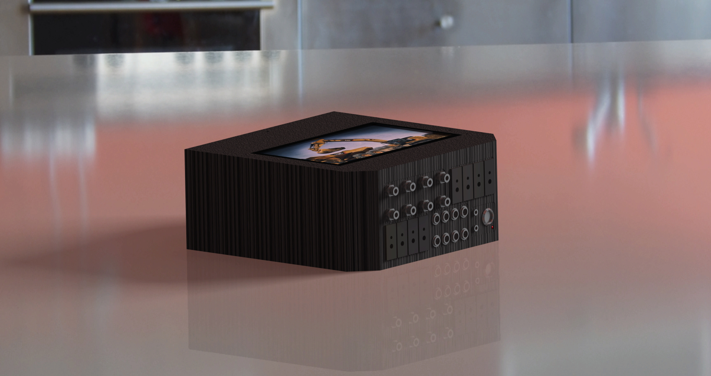
Rending A

Slide 3
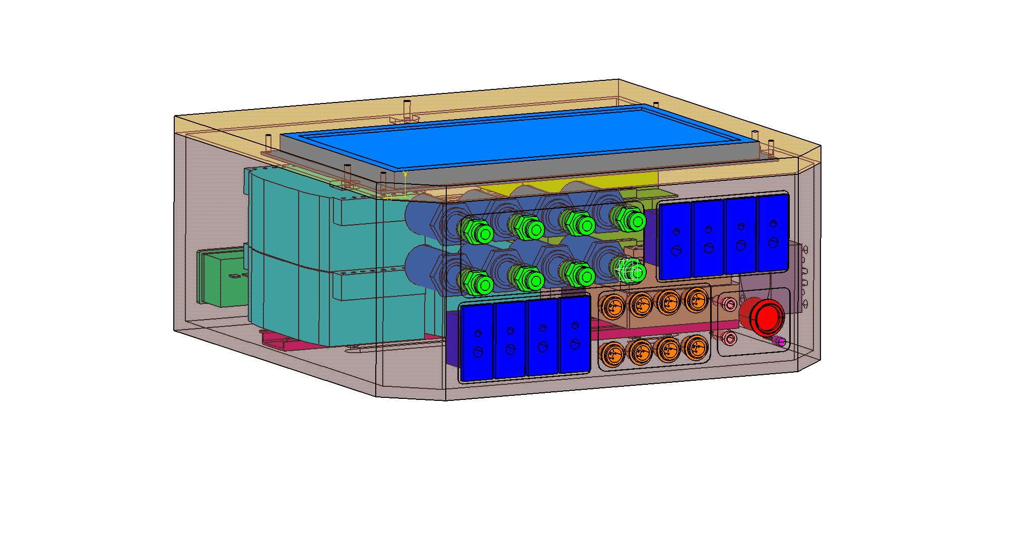
Size
Size
Lenght | 286mm
Wide | 288.5mm
High | 126.1mm

Slide 4
Picture A

Slide 5
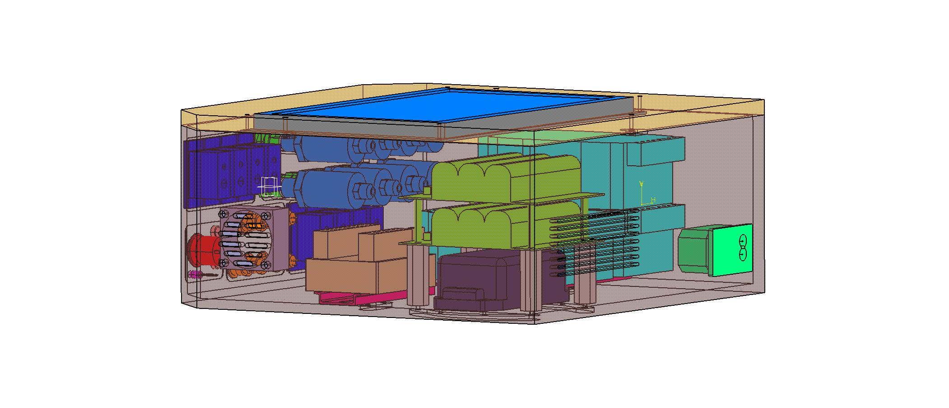
Picture B

Slide 6
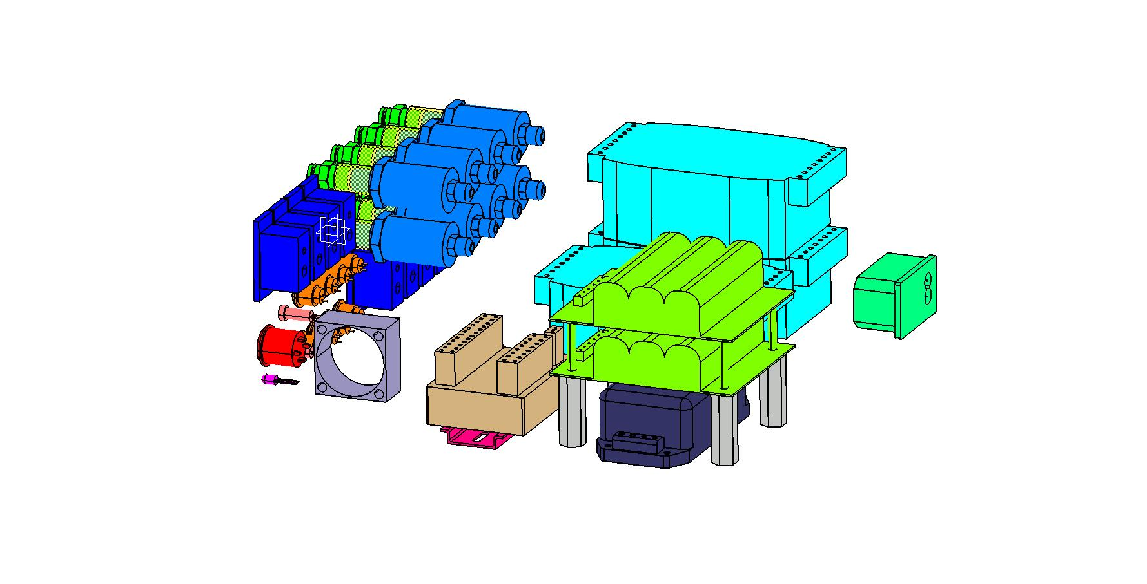
Picture C

Slide 7
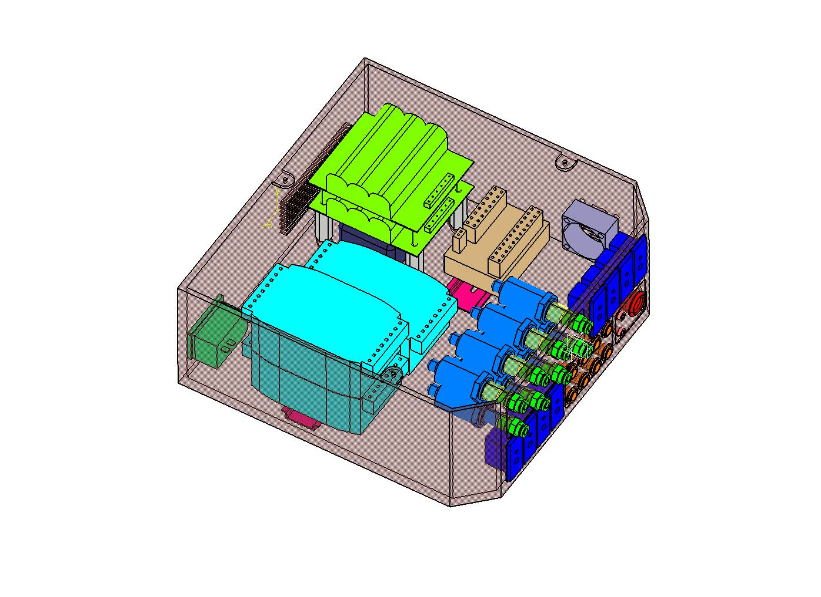
Picture D

